Slide 1
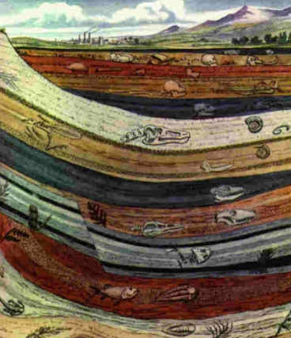
Fossil Evidence for Evolution 2
Absolute Dating continued: Tree Ring Dating
Relative Dating: Stratigraphy

Slide 2
Date: | Human Biology Year 12 ATAR
Do Now Past Exam Question Lesson Agenda 1: Do Now 2: Fossils and Absolute Dating Techniques cont… 3: Lesson Summary and Wind Up Suggested Study Read through today’s notes and textbook section Complete review worksheet, then mark and correct using the answer key on Connect (compulsory). NEXT LESSON Relative Dating Techniques – Fluorine dating Geological timescale Phylogenetic tree diagrams | Learning Aims Define dendrochronology and describe how it works Give an example of where dendrochronology has been used to date an archaeological site. List limitations of dendrochronology Define relative dating and compare it to absolute dating Define stratigraphy and state the main concepts. Describe the Principle of Superposition Describe the principle of Correlation of rock strata Use correlation of rock strata to determine which is the older of two fossils Define the term “index fossil” and describe what features make an index fossil useful. Describe the use of fossil pollen grains in stratigraphy
 | Key Vocabulary Dendrochronology Stratigraphy Superposition Correlation Index Fossil

Slide 3
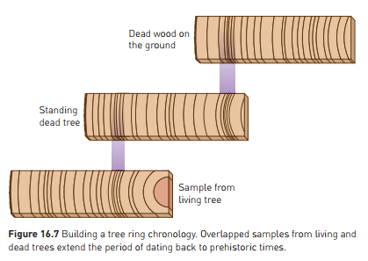
Absolute Dating: Tree Ring Dating (Dendrochronology)
Trees grow concentric rings
Each ring = 1 year growth
Differ in width according to how good the growing season is (water etc)
Create a “Timeline” in the tree trunk
Can match years by comparing one sample to another.
Can therefore match historically, and count years.
Learning Aim: Define dendrochronology and describe how it works.

Slide 4
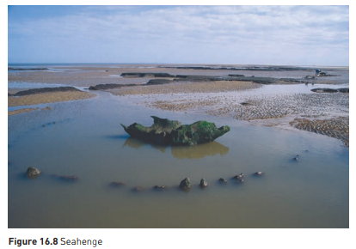
Absolute Dating: Tree Ring Dating (Dendrochronology)
Old, living trees are particularly useful for this
Bristlecone pine – USA – living trees up to 4500 years old
Can then look at dead trees, and backtrack using comparison
Can date very accurately back to 8600 years ago
Can use this to verify accuracy of Carbon-14 dating
Example: Seahenge
Timber circle – coast of England
Analysis of central stump using combo of tree-ring and carbon dating
Middle stump: tree chopped down in 2049 BC (4000 years ago), and was 167 years old when felled.
Limitations:
Timber only rarely preserved long enough to do long dating
Depends on having a continuous succession of nearby timber
Learning Aim: Give an example of where dendrochronology has been used to date an archeological site. List limitations of dendrochronology.

Slide 5
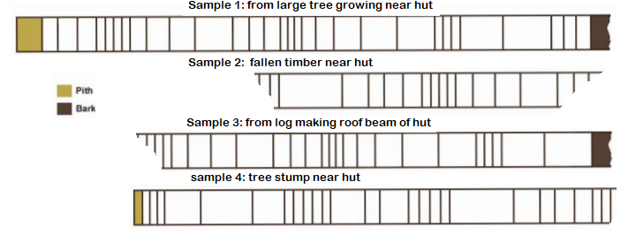
Dendrochronology Example
A group of Year 12 students are on a hike in the Perth Hills. As they trudge through the undergrowth, they stumble upon an old wooden hut. They remember the tale that a notorious Perth bank robber, “Robbin’ Byrne” hid out in the hills in the mid 1980s and that his hideout has never been found. They call the police, who send in a forensic investigation squad. The squad take a core sample from a large tree growing near the hut, and from a beam from the roof the hut. They also take a sample of old fallen timber nearby, and of a tree stump near the hut.
Could the hut have been built by “Robbin’ Byrne”? Use your dendrochronology skills to find out!
Learning Aim: Model the process of determining age of a sample using dendrochronology.

Slide 6
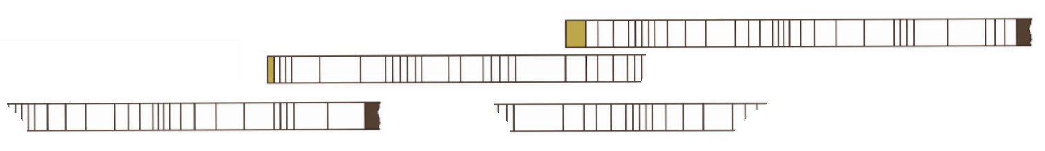
Could “Robbin’ Byrne” have built the hut?
How old is Sample 1?
When did Sample 4 first start to grow?
What years are represented in Sample 2?
What is the earliest year represented by these timber samples?
Give an example of a year with good rainfall.
Give an example of a year with poor rainfall.
Learning Aim: Model the process of determining age of a sample using dendrochronology.

Slide 7
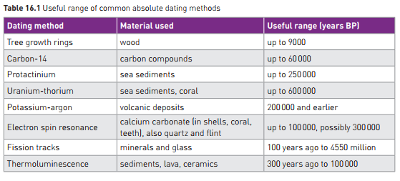

Slide 8
Relative Dating
Does not give an age. Says whether a sample is older or younger than other samples.
Enables sequence of events to be established.
Examples:
Stratigraphy
Fluorine Dating
(Compare to absolute dating, which gives an age in years before the present day)
Learning Aim: Define relative dating and compare it to absolute dating.

Slide 9
Relative Dating - Stratigraphy
Stratigraphy is the study and comparison of rock layers, or strata, and the fossils they contain, to determine relative age sequence.
3 main concepts:
Principle of Superposition
Correlation of Rock Strata
Index Fossils
Fossil pollen grain analysis can help confirm other data
Learning Aim: Define stratigraphy and state its main concepts.

Slide 10
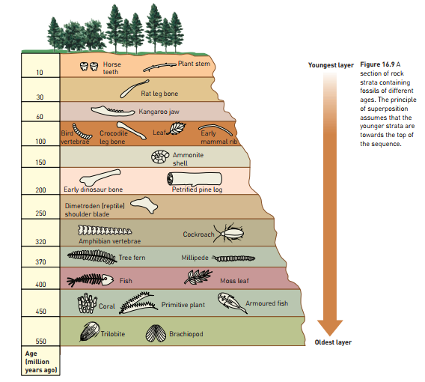
Stratigraphy – Principle of Superposition
Principle of Superposition
In sedimentary rock, layers at top are younger than layers beneath
Need to be cautious, as distortions of Earth’s crust can disturb layers, leading to inaccuracy.
Learning Aim: Describe the principle of superposition.

Slide 11
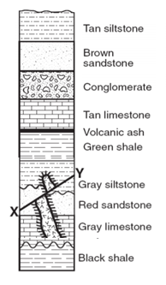
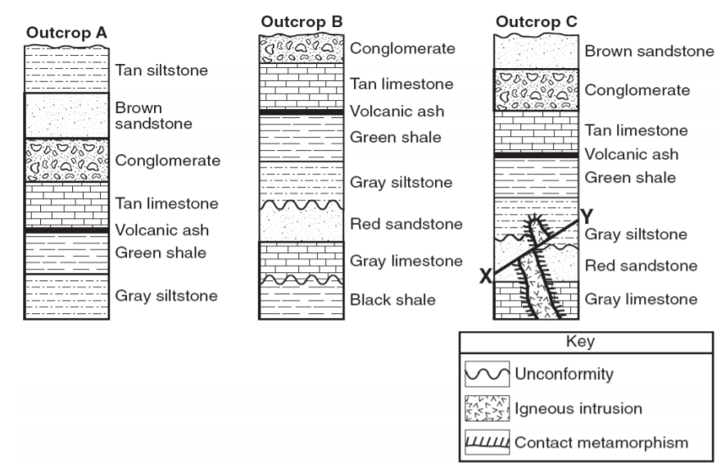
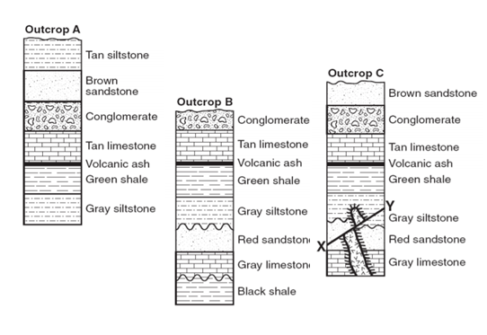
Stratigraphy – Correlation of Rock Strata
Correlation of Rock Strata
Matching layers of rock from different areas.
Examining rock, and also fossils it contains.
Rocks containing similar fossils are likely to be of similar age.
Rock strata from different areas have similar layer sequences.
We can line up (correlate) those sequences
To provide a sequence of layers from oldest to youngest.
Learning Aim: Describe the principle of correlation of rock strata.

Slide 12
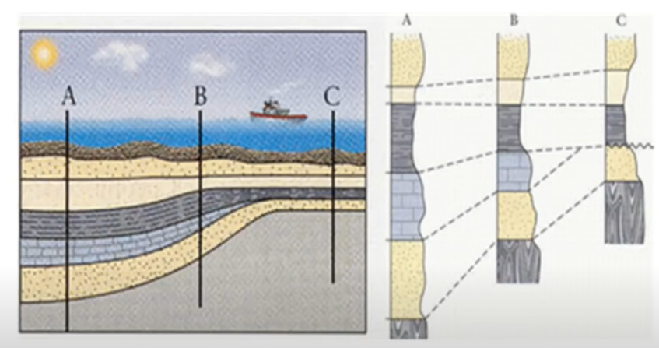
Stratigraphy – Correlation of Rock Strata
Correlation of Rock Strata
Sometimes layers can be missing:
Sediments may have eroded and then other sediments may be redeposited
One type of sediment may not be as widespread
We can still correlate using the similar layers:
Learning Aim: Describe the principle of correlation of rock strata.

Slide 13
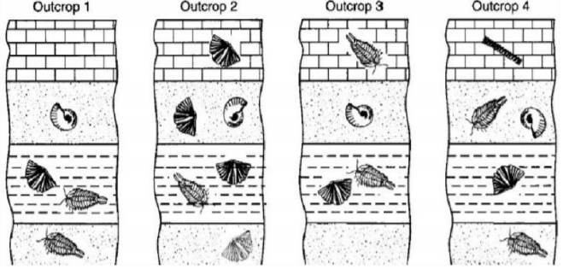
Stratigraphy – Index Fossils
Index fossils:
Widely distributed on earth but only present for a short historical time.
Can be used to correlate strata from different areas of the earth
Which of the fossils shown could be used as an index fossil?
Which organism evolved most recently?
Which organisms existed for the longest period of time?
Learning Aim: Use correlation of rock strata to determine which is the older of two fossils.
Learning Aim: Define the term index fossil and identify features that make an index fossil useful.

Slide 14
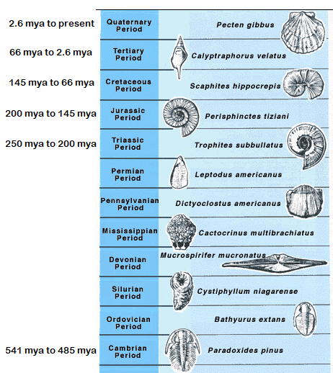
Stratigraphy – Index Fossils
Some examples of index fossils used to determine age of rock layers:

Slide 15
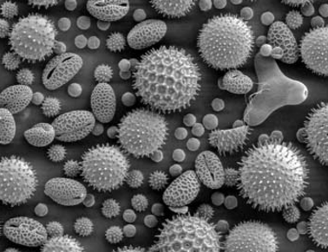
Stratigraphy – Fossil Pollen Grain Analysis
Pollen is produced by flowering plants and is unique to each species of plant.
Can be seen under a microscope.
Fossil pollen grains:
Some useful as Index Fossils (if plant was widespread but only around for a short time period)
Can be used to get a picture of type and amount of vegetation present at the time the fossils formed.
Can be used to infer information about climate.
Can then be used to confirm relative dates
Learning Aim: Describe the use of fossil pollen grains in stratigraphy.

